Slide 1
Transformer Architecture
DSC 360: Building AI-Powered Applications
Sept. 22, 2025
Notes:
In today’s session, we will dive deeper into the architecture of Large Language Models. That is, how do we adapt the structure of the network to generate text sequences given some prompt?

Slide 2
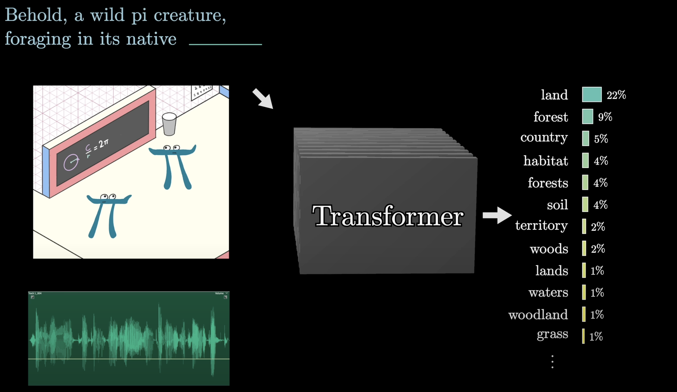
Notes:
Source: From today's assigned reading: https://www.3blue1brown.com/lessons/gpt

Slide 3
LLMs process tokens
Tokenizer breaks text into tokens (e.g., words or subwords)
Tokens sit between letters and words in granularity
Example: “Out walking!” → [“out”, “walk”, “ing”, “!”]
Smaller vocabulary: GPT-3 uses ~50,000 tokens vs. ~1M words
Tokens often relate to morphemes, encoding meaning
Notes:
Recall from last time that LLMs process tokens rather than words or letters.
Tokens are the units of text that language models process, and they fall between letters and words in terms of granularity. For example, “Out walking!” could be tokenized into four pieces: “out,” “walk,” “ing,” and “!” Tokens are designed to strike a balance: more granular than words, but less granular than letters. This is key because tracking every word in English, with its vast vocabulary of over 1 million words, would be inefficient. Instead, models like GPT-3 use a smaller vocabulary of around 50,000 tokens.
Tokens often correspond to morphemes, the smallest meaningful units in language. This means they can encode meaning more effectively than letters, while still handling rare or novel words by breaking them into smaller components.

Slide 4
Positional Encoding
Transformers process inputs in parallel
Need to encode order of tokens
Example: Adding positional embeddings
Notes:
Transformers process tokens in parallel, which makes them efficient but creates a challenge: how do they understand the order of words? For example, "The cat chased the dog" is very different from "The dog chased the cat." To solve this, transformers add positional encodings to token embeddings. These encodings, which can be sinusoidal or learned, help the model retain information about word order while processing sequences.

Slide 5
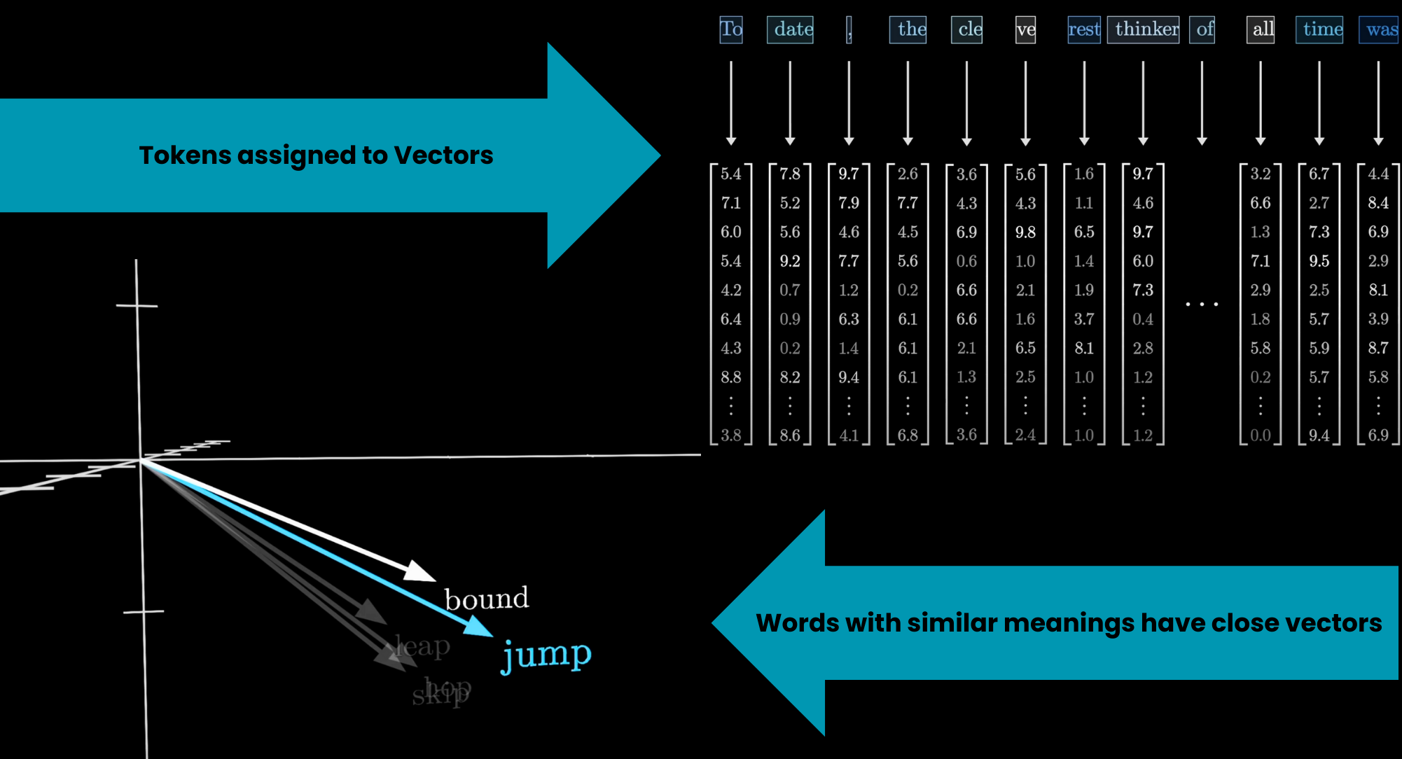
Notes:
Source: From today's assigned reading: https://www.3blue1brown.com/lessons/gpt

Slide 6
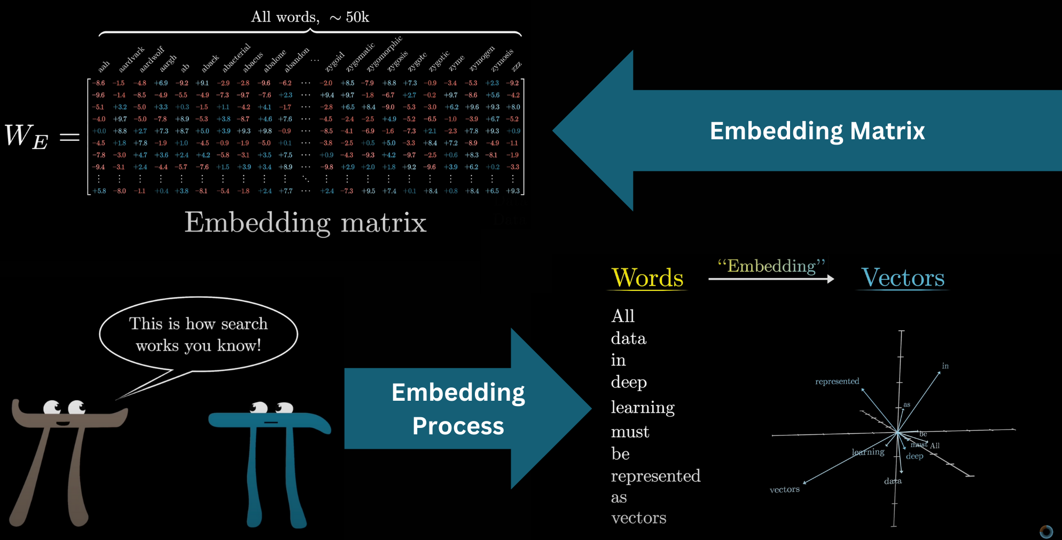

Slide 7
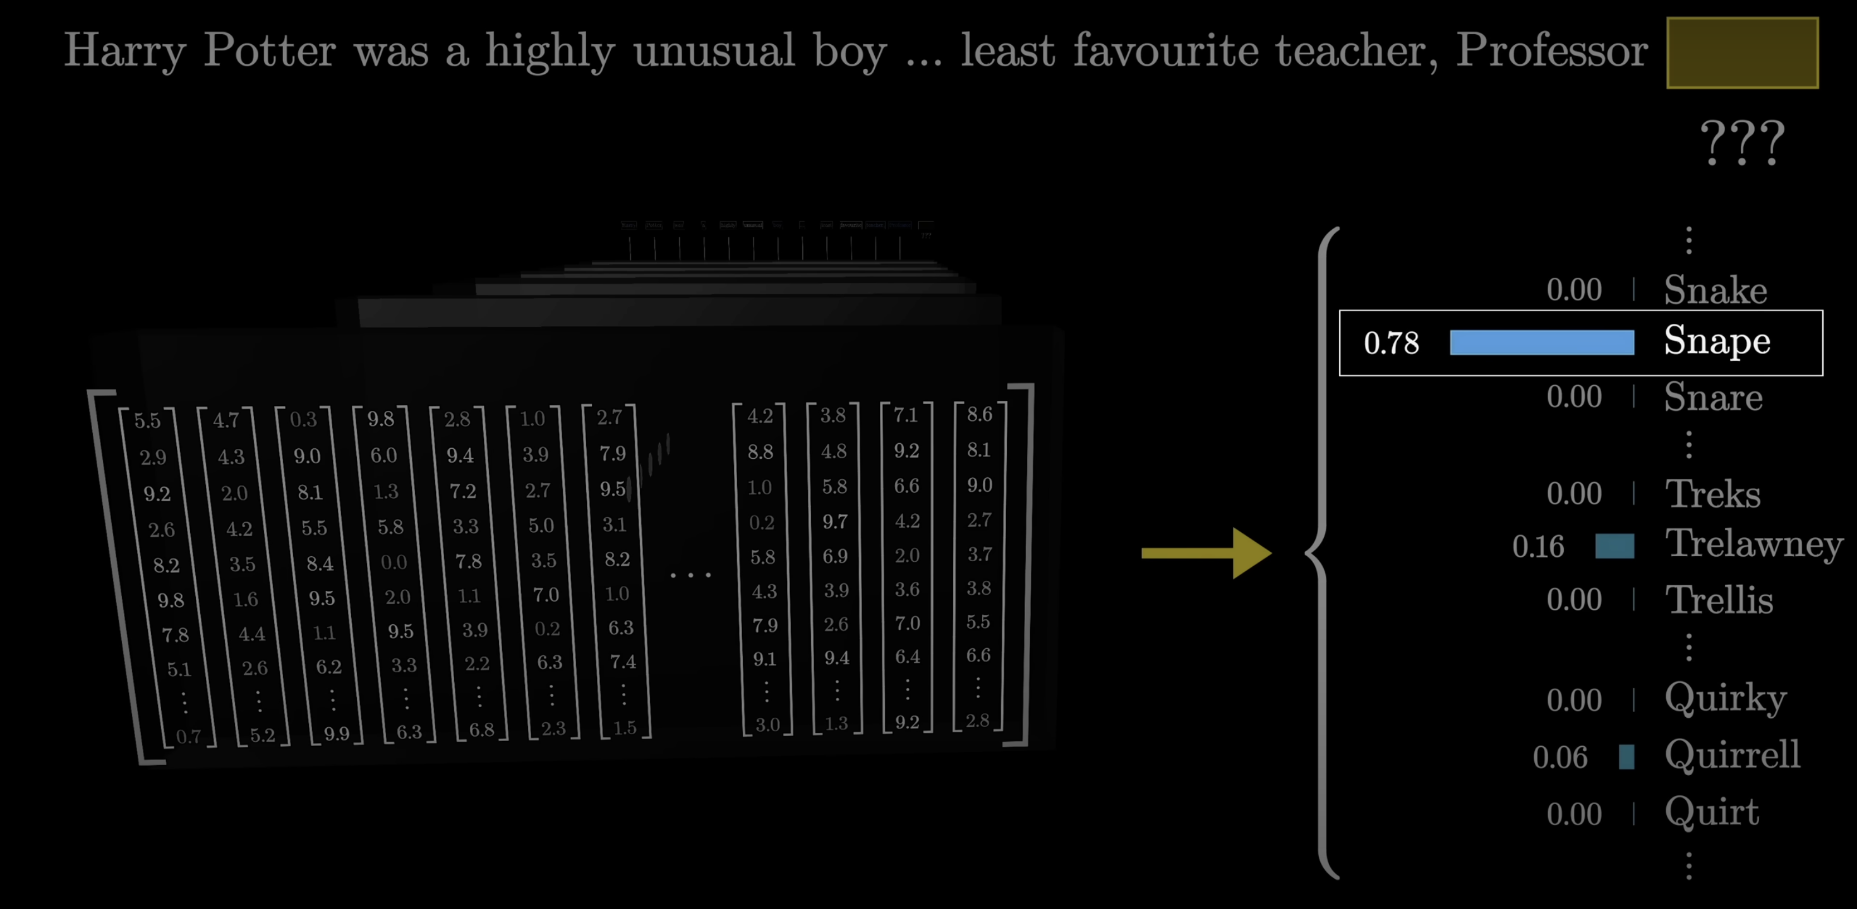

Slide 8
Generating Text: The Basics
Generating Text: The Basics
Task: Predict the next token based on context
Softmax: Converts outputs into probabilities
Sigmoid : Step Function :: Softmax : Max
Forces all values to be between 0.0 and 1.0
Forces the values to add up to 1.0
Temperature: Adjusts "creativity" in predictions
Low temperature → Predictable
High temperature → Surprising
Notes:
When generating text, the model’s primary task is to predict the next token based on the tokens it has already seen. This process is probabilistic, meaning the model doesn’t just choose the most likely word—it assigns probabilities to all potential next tokens. These probabilities are calculated using a function called softmax, which ensures they sum up to 100%.
We can also control how creative the model’s responses are by adjusting a parameter called temperature. At low temperatures, the model becomes more predictable, sticking to the most likely next token. At high temperatures, it explores less likely options, which can lead to more surprising or creative outputs. For example, at a low temperature, “The dog chased the...” might reliably predict “ball,” while a high temperature might occasionally generate “neighbor” or even “squirrel.”

Slide 9
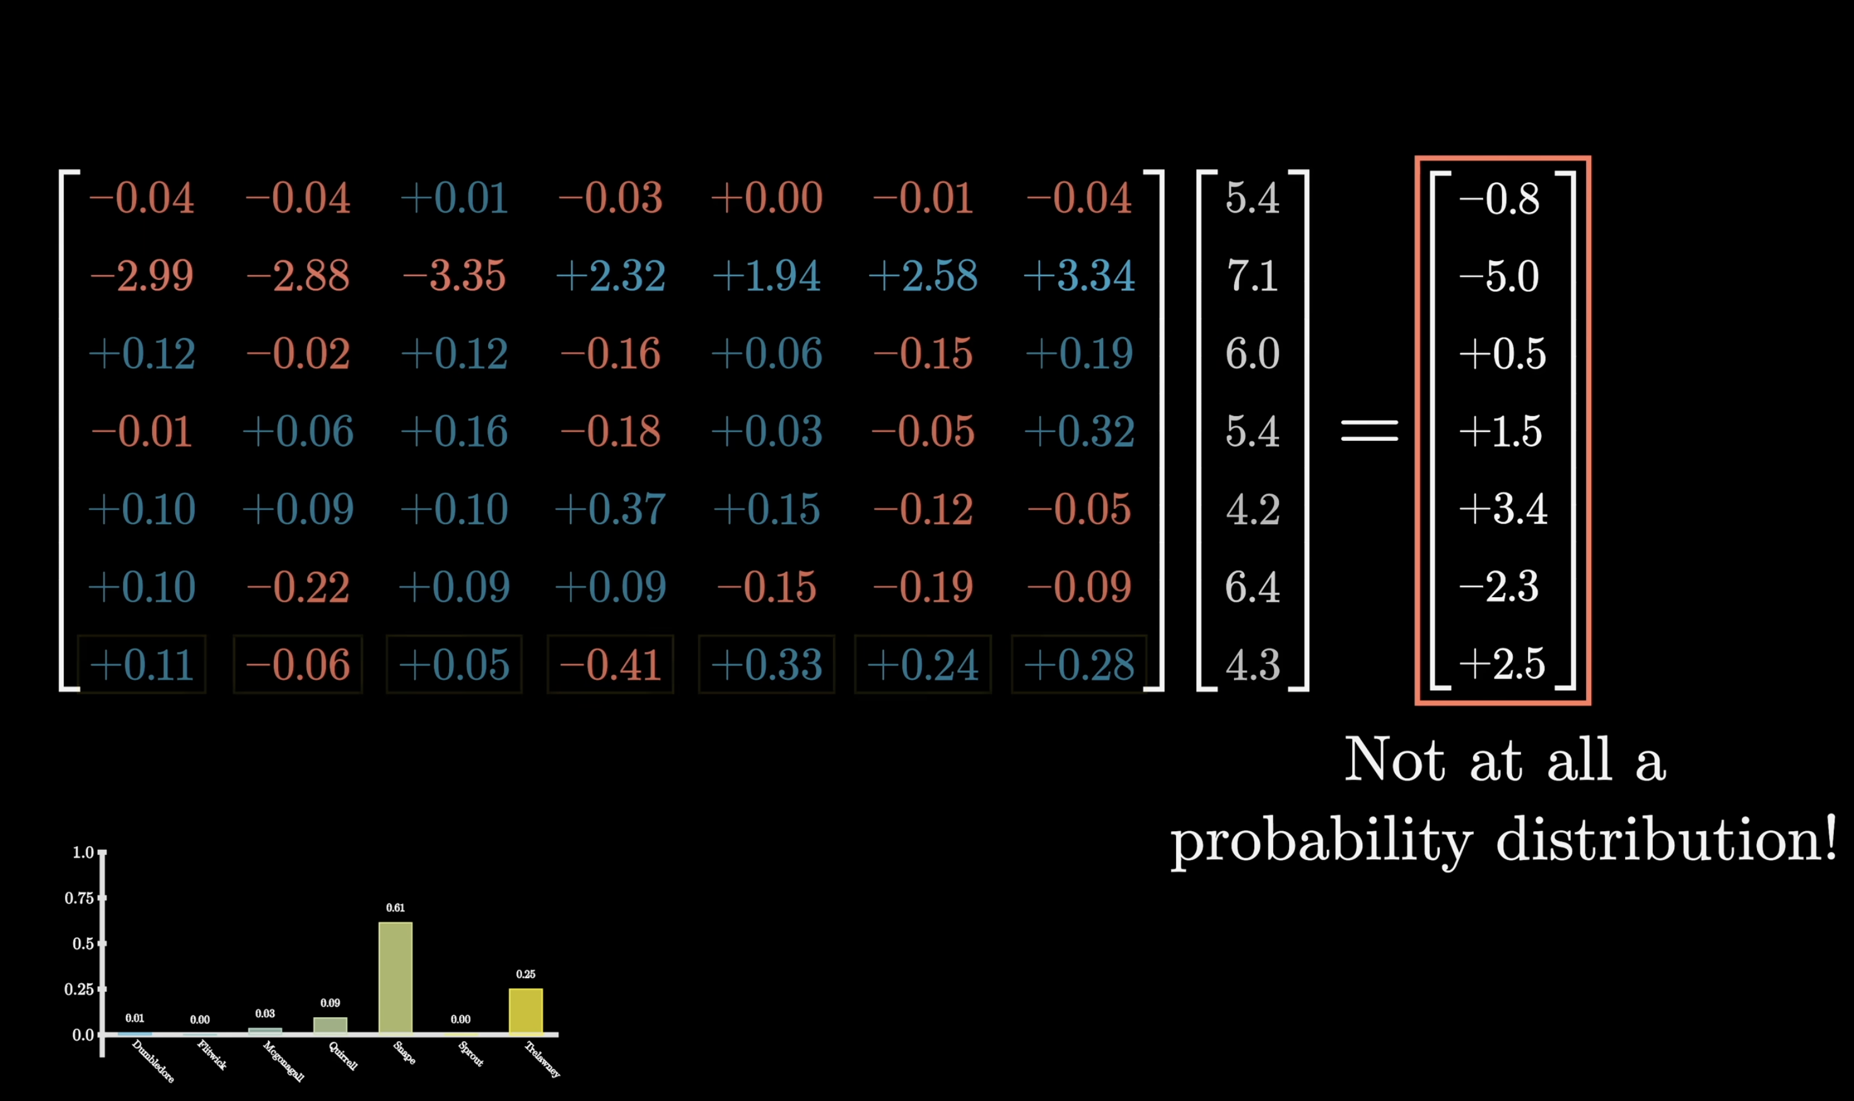

Slide 10
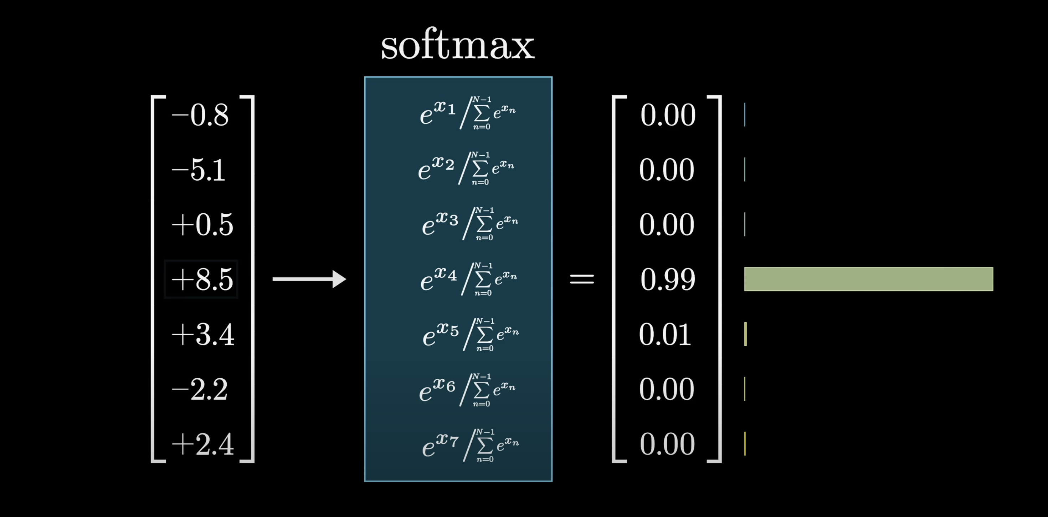

Slide 11
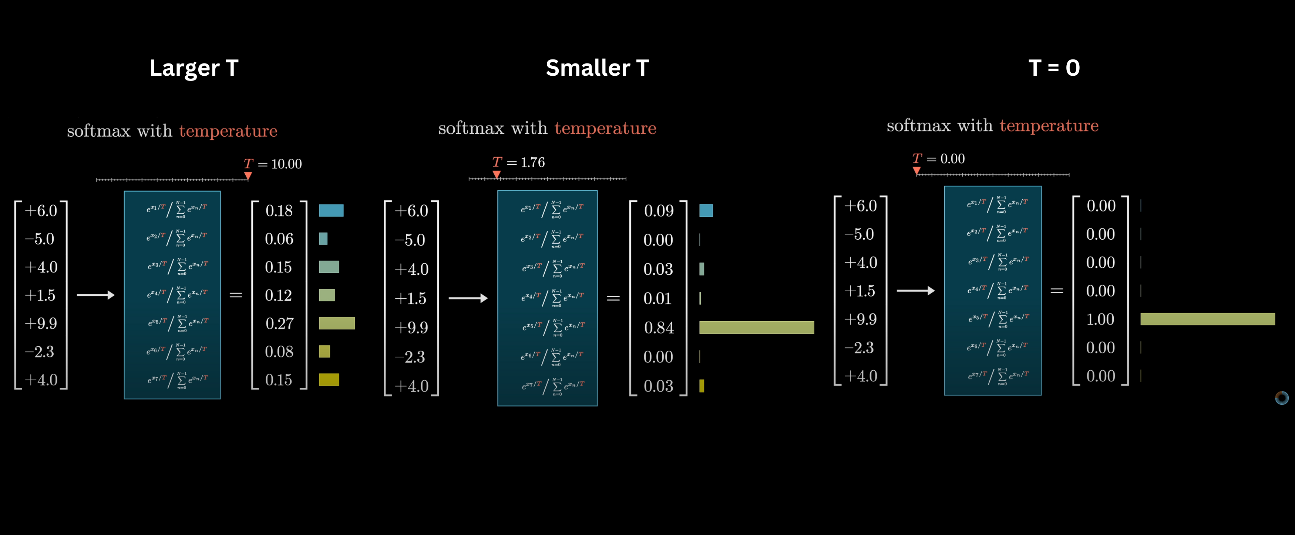

Slide 12
Controlling Text Generation
Top-k sampling: Limits predictions to the k most probable tokens
Top-p (nucleus) sampling: Focuses on a dynamic probability threshold
Temperature, Top-k, and Top-p shape creativity and coherence
Applications: Chatbots, story generation, creative writing
Notes:
OpenAI models rely on sampling-based methods to generate text, ensuring outputs are natural and varied. One method is top-k sampling, where the model restricts its choices to the k most probable tokens. Another is top-p sampling, or nucleus sampling, which focuses on the smallest set of tokens whose combined probabilities exceed a certain threshold.
These parameters work together with temperature to balance creativity and coherence. For example, in chatbots, you might use a lower temperature and nucleus sampling for clear, concise answers. In creative writing, higher temperatures and more open sampling can produce more imaginative results. These controls are key to tailoring model behavior for different applications.

Slide 13
Attention Mechanism: The Basics
Predictions depend on context
Key idea: Focus on important words in the input
Attention scores: Measure relevance between tokens
Example: “The cat ate because it was hungry.”
Focus: Link “it” to “cat,” not “ate”
Notes:
The attention mechanism is like a spotlight that helps the model focus on the most important parts of the input. Instead of treating all tokens equally, attention assigns a score to each token, measuring its relevance to the current task.
For example, in the sentence, “The cat ate because it was hungry,” the model needs to figure out that “it” refers to “cat.” The attention mechanism calculates relationships between tokens and assigns higher scores to more relevant ones. This ensures the model focuses on the right connections when making predictions.

Slide 14
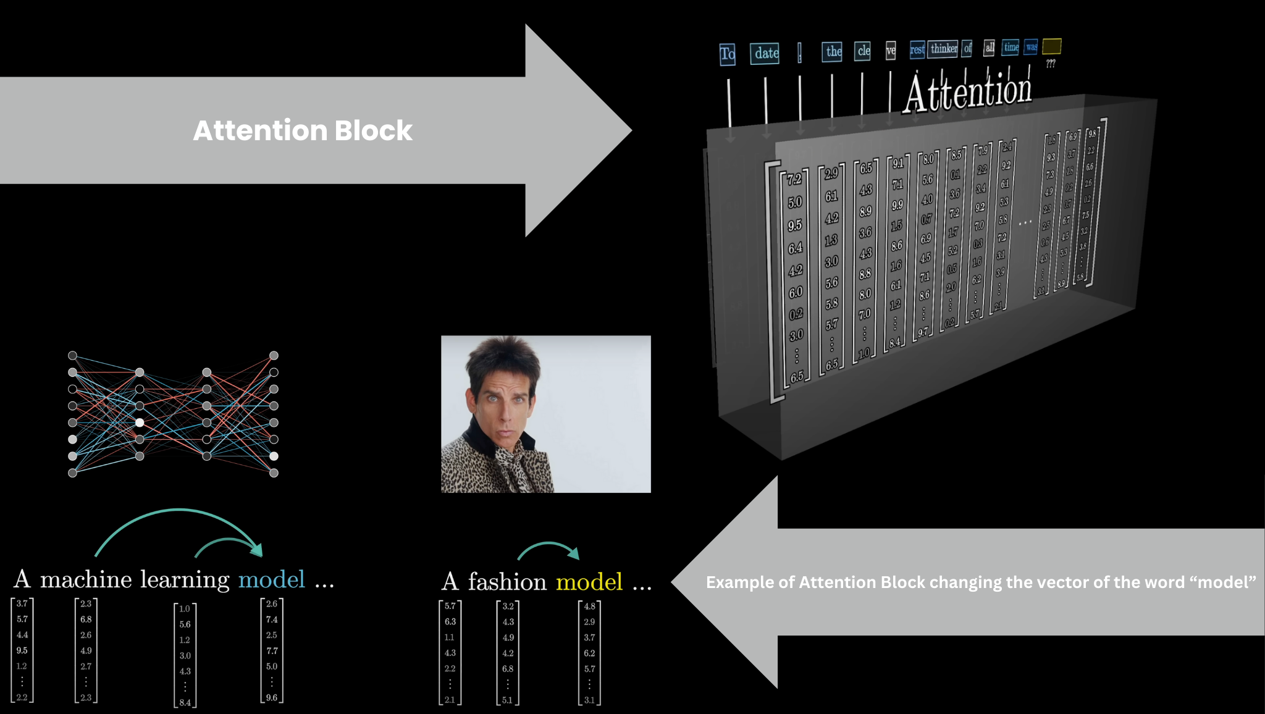
How Transformers Address Context
Meaning of a token depends on context.
Attention mechanism: Weighs relevant parts of input text.
Example: “The cat ate its food because it was hungry.”
Self-attention: Focuses on “cat” for it was hungry
Large context windows: Modern models can process thousands of tokens
Notes:
Transformers solve the problem of long-range dependencies with the attention mechanism, which allows them to focus on the most relevant parts of the input text, no matter how far apart they are.
For example, in the sentence “The cat ate its food because it was hungry,” a transformer uses self-attention to weigh the relationship between “it” and “the cat.” This helps the model resolve ambiguity in ways older methods couldn’t.
Another key innovation is the use of large context windows. Unlike earlier models that were limited to a small number of tokens, transformers can process thousands of tokens at once, allowing them to understand and generate coherent responses for much longer inputs. This is one of the reasons why transformers like GPT excel at tasks involving detailed or extended text.

Slide 15
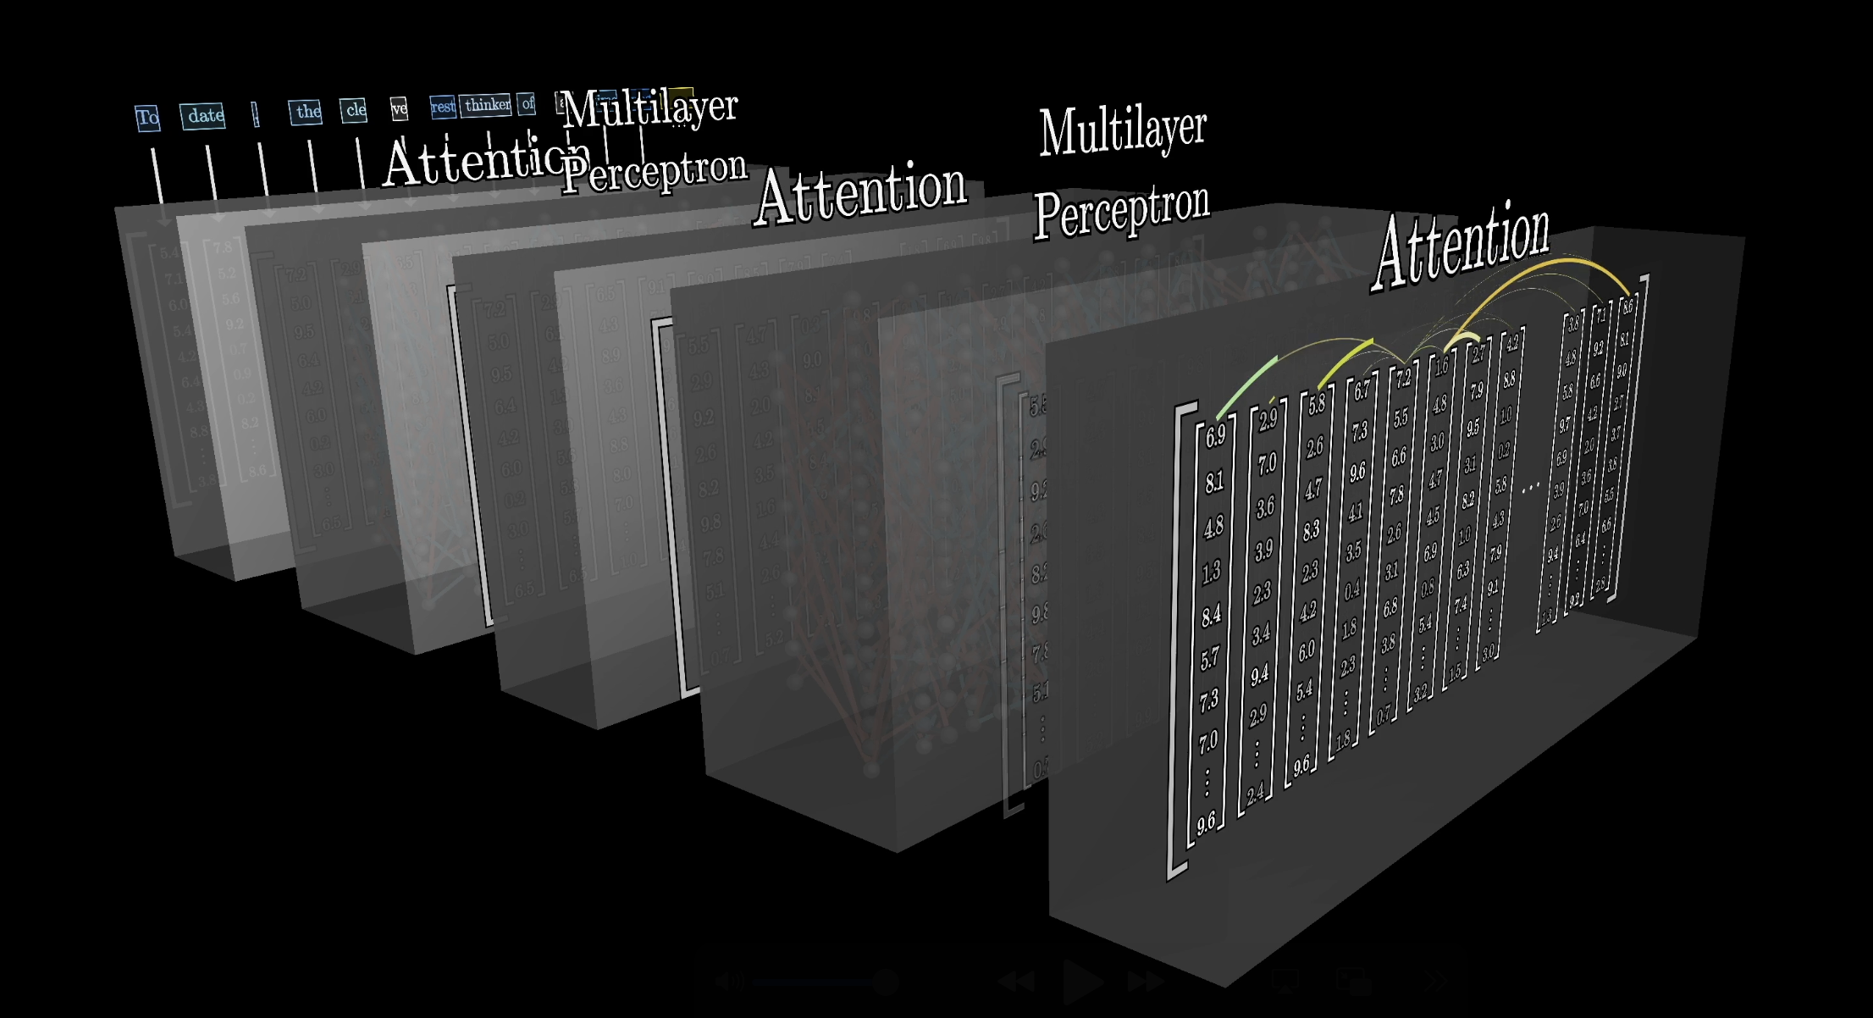
Notes:
Source: From the assigned readings: https://www.3blue1brown.com/lessons/attention

Slide 16
How Attention Works: Queries, Keys, Values
Each token creates:
Query: What are we looking for?
Key: What information do we have?
Value: The actual information
Example: Linking “it” to “cat”
Query: “it” → What is “it” referring to?
Key: “cat” → How relevant is “cat” to “it”?
Value: “cat” → The actual meaning to focus on
Notes:
The attention mechanism operates using three components for every token: queries, keys, and values.
A query asks, “What are we looking for?” For example, “it” generates a query to find its reference.
A key asks, “What information do we have?” Each word, like “cat,” generates a key that signals its relevance.
A value is the actual information stored in the token. If “cat” is deemed relevant, its value is used in the output.
In practice, the model compares queries and keys to compute attention scores. These scores determine how much focus the model places on each token, ensuring the right relationships are prioritized.

Slide 17
Self-Attention: Key Feature of Transformers
Self-attention: Each token attends to all tokens, including itself
Importance: Captures relationships across the sequence
Efficient: Parallel processing speeds up computation
Notes:
Transformers take the attention mechanism further with self-attention, where each token attends to all other tokens in the sequence—including itself. This is crucial because it allows the model to capture relationships regardless of their position.
For example, in “The cat ate because it was hungry,” self-attention ensures that “it” can connect to “cat,” even if they’re several words apart. Importantly, this process is done in parallel, which makes transformers much faster and more efficient than older models like RNNs.

Slide 18
Multi-Headed Attention: The Basics
Why multiple heads?
Focus on different aspects of relationships in the text
Example: Syntax vs. semantics
How does it work?
Split queries, keys, and values into multiple heads
Process each head independently
Combine results for richer understanding
Notes:
Multi-headed attention extends the basic attention mechanism by using multiple “heads” to focus on different relationships in the text at the same time. Each head captures a unique perspective.
For example, one head might focus on syntax—like the grammatical relationships between words—while another focuses on semantics, understanding the meaning. This parallel processing allows transformers to capture complex, nuanced relationships more effectively.
Here’s how it works: the model splits the queries, keys, and values into multiple smaller sets, called heads. Each head processes its part of the data independently. The outputs are then combined and fed into the next layer, providing a richer representation of the input text.

Slide 19
Why Multi-Headed Attention Matters
Handles complex relationships: Syntax, semantics, and context
Enables parallel processing for efficiency
Example: “The cat chased the mouse because it was hungry.”
Head 1: Links “it” to “cat” (semantic focus)
Head 2: Tracks subject-verb agreement (syntax focus)
Notes:
Multi-headed attention is powerful because it can focus on different aspects of the text simultaneously. This makes transformers exceptionally good at handling complex relationships.
For example, in the sentence “The cat chased the mouse because it was hungry,” one head might link “it” to “cat,” focusing on semantics, while another head ensures subject-verb agreement, focusing on syntax. This parallel processing makes transformers both effective and efficient.
By dividing attention across multiple perspectives, multi-headed attention helps the model create a deeper, more nuanced understanding of the input.

Slide 20
How Multi-Headed Attention Works
Split: Divide queries, keys, and values into smaller subsets
Independent processing: Each head focuses on a unique aspect
Combine: Merge results into a single output
Notes:
To understand the mechanics of multi-headed attention, think of it as dividing the model’s attention resources into smaller chunks. Queries, keys, and values are split into subsets, and each subset is processed by an independent head.
This division allows each head to focus on different parts of the input or relationships within the text. Once all heads have done their work, the outputs are combined into a single representation, which is passed to the next layer.
This process ensures that no single head becomes overwhelmed and that the model can capture a wide variety of relationships, from word meanings to sentence structure.

Slide 21
Fine-Tuning: Adapting Pretrained Models
Process: Customize a general model for a specific task
Saves time and resources: Build on pre-trained knowledge
Example: Fine-tune GPT for medical Q&A or legal analysis
Notes:
Fine-tuning is how we take a general-purpose model like GPT and adapt it to perform well on a specific task. Instead of training from scratch, which would require immense resources, we fine-tune the model using a smaller, specialized dataset. This saves both time and resources while leveraging the pre-trained model's broad knowledge.
For example, a healthcare provider might fine-tune GPT on medical texts to create a system for answering medical questions. Similarly, a law firm could fine-tune it on legal documents for tasks like contract analysis or summarization.

Slide 22
RLHF
Reinforcement Learning with Human Feedback
Aligning Models with Human Intent
Combines human input with reinforcement learning
Human feedback guides the model’s behavior
Example: Training ChatGPT to provide polite, helpful answers
Notes:
Reinforcment Learning with Human Feedback, or RLHF, is a method to align models with human intent and values. It involves using human feedback to guide the model’s responses, ensuring they are polite, helpful, and aligned with the user’s expectations.
For instance, when training ChatGPT, human reviewers rate the model’s responses during its fine-tuning phase.
These ratings are then used in a reinforcement learning loop to adjust the model’s behavior, prioritizing answers that align better with user needs. RLHF is one of the reasons ChatGPT excels at producing user-friendly and safe interactions.

Slide 23
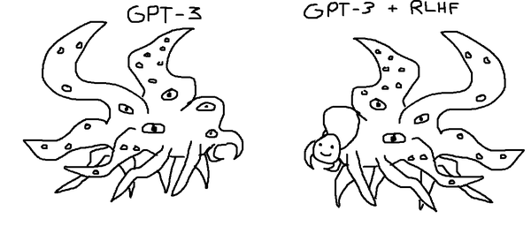
Shoggoth RLHF Meme
https://www.nytimes.com/2023/05/30/technology/shoggoth-meme-ai.html
Notes:
[I mentioned this in class. The meme is shown above.]
This slide shows the Shoggoth meme, which has become a popular metaphor in the AI community for explaining the inner workings and quirks of large language models (LLMs). The image—a monstrous creature with a smiley-face mask—represents the disconnect between the polished, user-friendly interface we interact with and the complex, opaque, and often unpredictable processes beneath the surface. The smiley face, labeled "RLHF" (Reinforcement Learning from Human Feedback), symbolizes the fine-tuning process used to align AI outputs with human values, making the system appear more coherent and helpful. The meme gained prominence as chatbots like Bing and ChatGPT became mainstream, especially when their unintended or bizarre behaviors, such as Bing's infamous meltdown, raised questions about their reliability and safety. It humorously encapsulates the tension between the powerful, alien nature of these systems and the efforts to make them appear safe and trustworthy.
Source: https://www.nytimes.com/2023/05/30/technology/shoggoth-meme-ai.html

Slide 24
Applications
Chatbots (e.g., customer service, tutoring)
Translation (e.g., real-time, multilingual systems)
Creative writing (e.g., poetry, screenwriting, brainstorming)
Notes:
Transformers power some of the most impressive AI applications today.
For instance, chatbots like ChatGPT excel at customer service, personal tutoring, and interactive storytelling.
Translation systems now handle real-time, multilingual communication, bridging language barriers.
Creative fields could also benefit, with AI assisting in poetry, screenwriting, and even generating ideas.

Slide 25
Limitations and Concerns
Context window: Limited capacity for long documents
Hallucinations: Generates false or misleading information
Biases: Reflects biases in training data
Ethical concerns: Energy consumption, misinformation risks
Notes:
However, these models have significant limitations. As we've already discussed, they are constrained by their context window, meaning they may lose coherence in longer documents.
In addition, they can also produce hallucinations, generating false or misleading information confidently. Biases in the training data can lead to problematic or unfair outputs, raising important ethical questions. Lastly, the energy consumption of training and running these models is immense, contributing to environmental concerns. As transformers become more widely used, the risks of misinformation and misuse, such as deepfakes or malicious content, are critical to address. This underscores the importance of ethical development and responsible use. We will explore these issues—and others—in the next unit.

Slide 26
Wrap-Up and Next Steps
Transformers revolutionized AI with attention
GPT is a powerful generative model
Next time: LLMs in agents and RAG
Notes:
To wrap up, we’ve seen how transformers revolutionized AI with the concept of attention, enabling models like GPT to process language in unprecedented ways. GPT’s ability to generate text, adapt to tasks, and model long-range dependencies is truly transformative. In our next lecture, we’ll explore how large language models are embedded in agents and how Retrieval-Augmented Generation (RAG) addresses the context window limitation by incorporating external knowledge sources.

